Slide 1
Green Mars
Deployable Greenhouse challenge.
Simon Rose & William Sellier

Slide 2
Objective
To develop an automated and self-deploying greenhouse on martian landscape as an advance life support system.

Slide 3
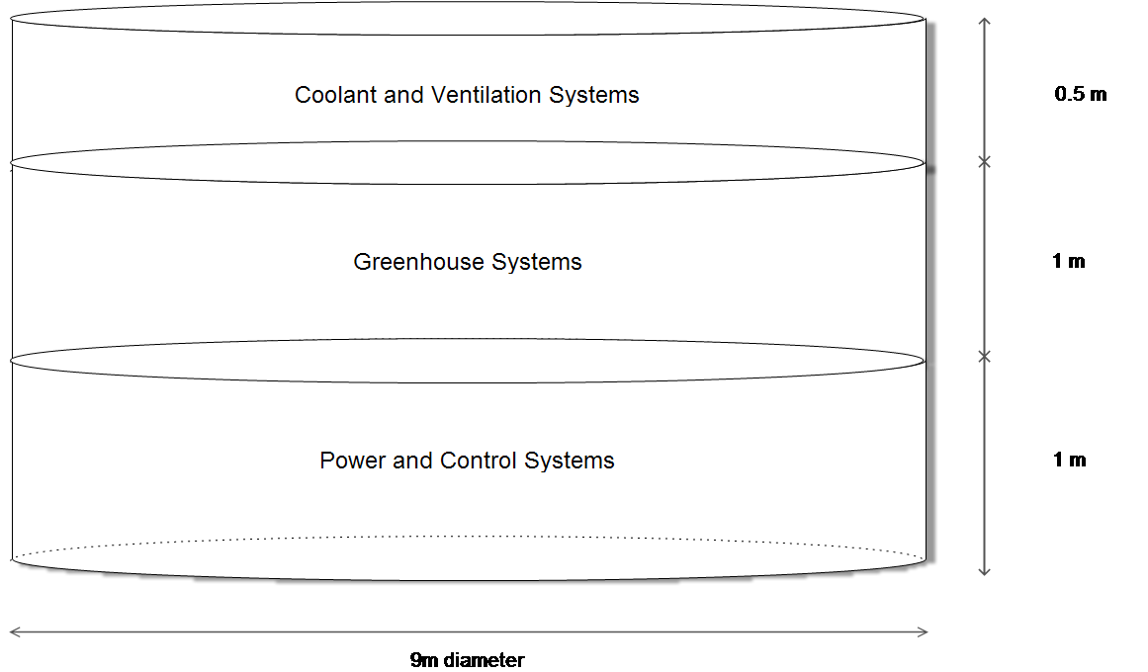
Concept Diagram

Slide 4
Basic Needs/Project Parameters
50 m² growing area.
600 W*m⁻² for photosynthesis.
Humidity:70%
Temperature:26.6°C
CO₂ and O₂ minimums.
Hypobaric conditions (28 kPa).

Slide 5
Problems
600 W*m⁻² is a lot of energy.
Heating the greenhouse.
Maintaining humidity.
Traditional growth media is heavy.

Slide 6
Solutions!!!

Slide 7
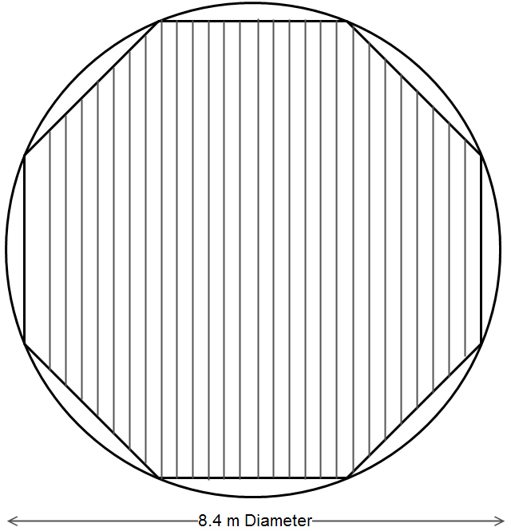
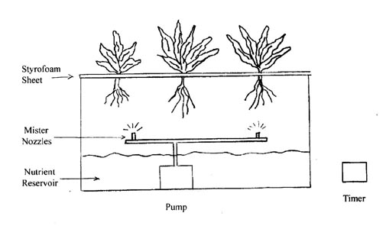
Aeroponics
http://www.microfarmsustainable.org/hydro.html

Slide 8
Radiation Energy Required
Reduced from 600 W*m⁻² to 260 W*m⁻² by selecting only light wavelengths which are required for photosynthesis.

Slide 9
Nuclear Power
Literature show small Advanced Stirling Radioisotope Generator capable of ~15 kW
NASA press release suggest small nuclear power units capable of up to 40 kW [They won’t talk to us about this… we tried].
This has added benefits…

Slide 10
Temperature and Humidity
Using portion of waste heat for water vaporization and temperature control.
Forcing of air also provides minimum circulation required for plant growth.

Slide 11
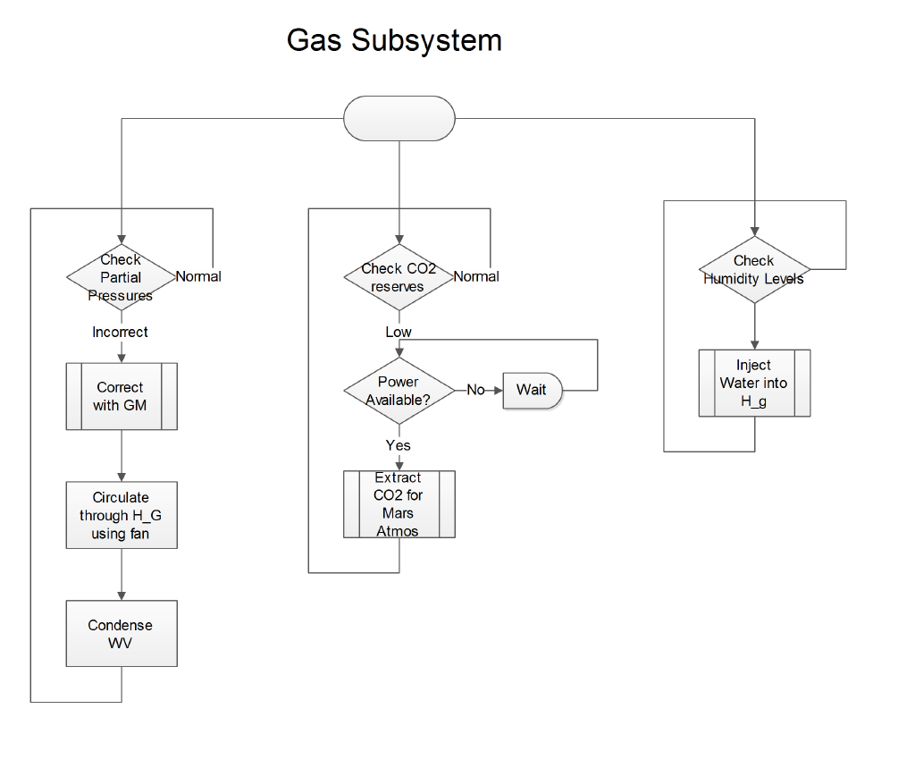
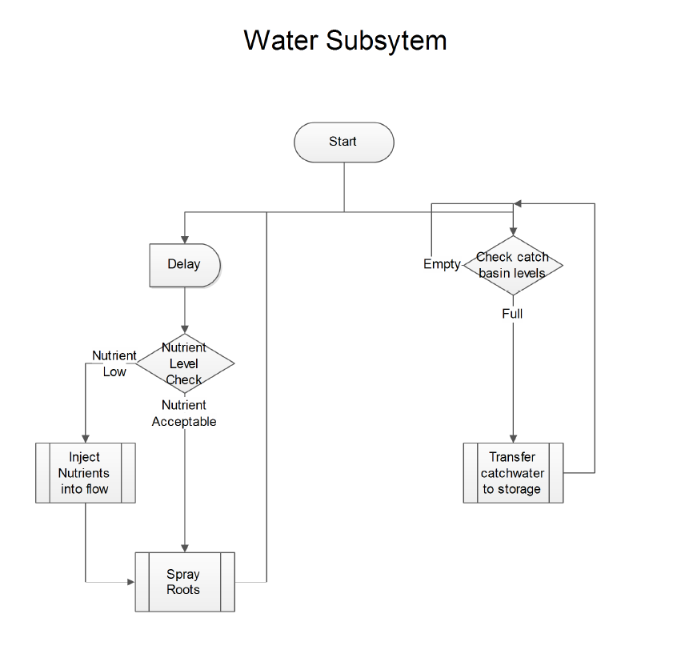
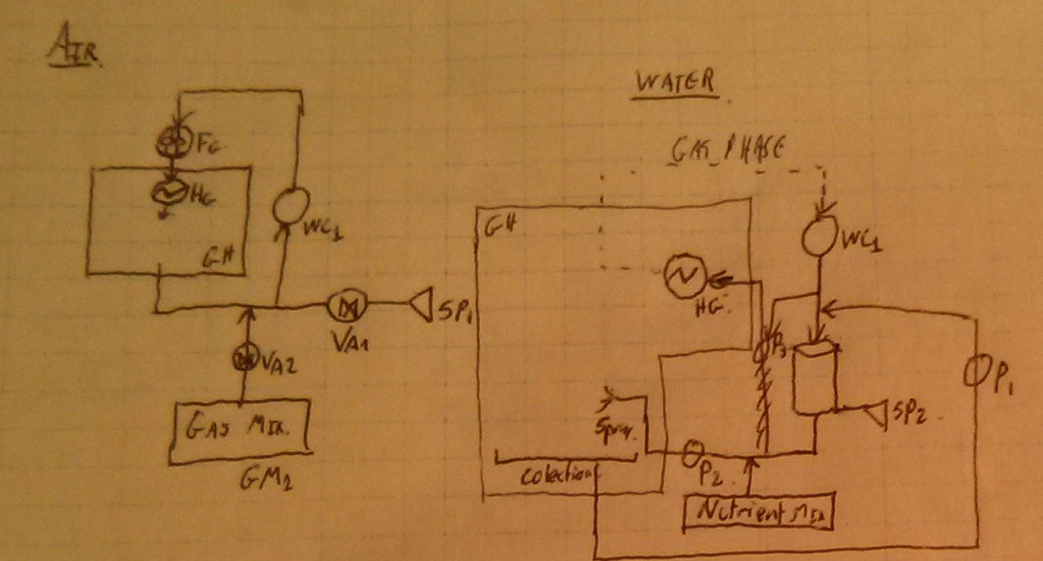
Closed Loop

Slide 12
Estimated Specs
20 kW energy requirement.
24 kg of various gasses.
15 kg of water for aeroponic system.
~1600 kg total mass
9m diameter x 2.5m height
Not even a problem
for the Saturn V

